Slide 1

Copy & paste me next to
Captain Earth’s Dishes
Dishes made with unpeeled produce, using whole vegetables (including leaves and stalks) and fruit sliced with the skin intact.

Slide 2
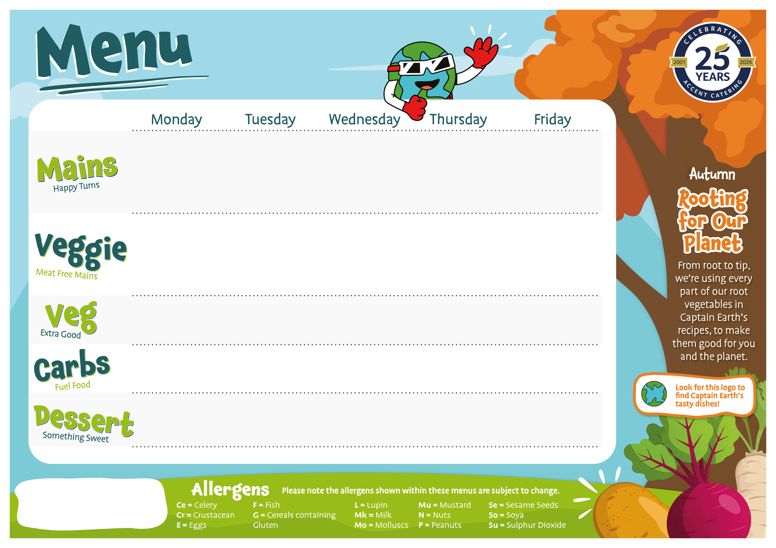
Margherita Pizza Slice (G,Mk) | Beef Meatballs in a Tomato Sauce (G) | Sticky Jerk Chicken with Jerk Gravy | Beef Mince and Bean Tacos (G) | Fish Fingers (G,F) or Salmon Fish Fingers (G,F) Tomato Ketchup
Margherita Pizza Slice (G,Mk) | Vegan Meatballs in a Tomato sauce (So) | Jerk Vegetables with Jerk Gravy | Vegan Mince and Bean Tacos Topped with Cheese (Mk,So,G) | Curried Carrot and Chickpea Patty (G,Mk)
Sweetcorn Roasted Broccoli with Edamame Beans (So) | Green Beans Carrots | Roasted Carrots Broad Beans | Celeriac Coleslaw (C,E,Mu,So,Su) Choose from our delicious Salad Bar | Peas Baked Beans
Potato Wedges | 50/50 Fusilli (G) | 50/50 Rice and Peas | Beetroot and Garlic Focaccia (G) | Chips
Fruit Platter | Jelly or Topped Yoghurt (Mk,So) | Pear and Vanilla Topsy Turvey Cake with Custard (G,E,Mk,So) | Jelly or Topped Yoghurt (Mk,So) | Ice Cream (Mk)
Jacket Potatoes, Salad Bar, Cold Desserts and Fresh Fruit Platters available daily.
Week 1
07/09/26, 28/09/26, 19/10/26, 16/11/26, 07/12/26

Slide 3
Vegan Bolognaise (G,So) | Chicken Enchilada in Tomato Sauce (G,Mk) | Roasted Chicken Sausage with Onion Gravy (G,Su) | Beef Keema and Pea Curry Mango chutney | Pollock Fillets (F,E) Served Tomato Ketchup
Quorn Bolognaise (G,So) | Tex Mex Smokey Bean and Vegetable Enchilada in a Tomato Sauce (G) | Vegetable Sausage with Onion Gravy (So) | Mild Root Vegetable and Chickpea Curry | Vegetable Fingers (G) with Tomato Ketchup
Broccoli | Mexican Sweetcorn Green Beans | Carrots Cauliflower | Mixed Vegetables | Peas Baked Beans
Garlic and Herb Focaccia (G) | Paprika Potato Wedges | Mashed Potato (Mk) | 50/50 Rice | Chips
Fruit Platter | Jelly or Topped Yoghurt (Mk,So) | Jam and Coconut Sponge (G,E,Mk) | Jelly or Topped Yoghurt (Mk,So) | Italian Lemon Cookies (G,E,Mk)
Jacket Potatoes, Salad Bar, Cold Desserts and Fresh Fruit Platters available daily.
Week 2
14/09/26, 05/10,26, 02/11/26, 23/11/26, 14/12/26

Slide 4
Vegetable Stir Fry (G,So) | Butter Chicken Curry | Roast Chicken with Yorkshire Pudding and Gravy (G,E,Mk) | Pasta Bar: (Wholemeal Penne (G)) Beef and Lentil Bolognaise (G) Tomato Sauce Cheddar Cheese and Leek Sauce (G,Mk) | Fish Fingers (G,F) or Salmon Fish Fingers (G,F) with Tomato Ketchup
Soya Julienne Root Vegetable and Chickpea Stir Fry (G,So) | Root Vegetable and Chickpea Curry | Cheesy Baked Quinoa and Broccoli Bites (G,E,Mk) | Pasta Bar: (Wholemeal Penne (G)) Tomato Sauce Cheddar and Leek Sauce (G,Mk) | Green Onion, Vegetable and Chickpea Bubble and Squeak
Cauliflower Broccoli | Carrot Green Beans | Honey Roasted Parsnips | Cabbage and Kale Roasted Sweetcorn | Peas Baked Beans
Egg Noodles (G,E) | 50/50 Rice | New Potatoes | Potato and Turmeric Focaccia (G) | Chips
Chocolate Brownie (G,E,MK) | Jelly or Topped Yoghurt (Mk,So) | Beetroot and Red Velvet Cake (G,E,Mk) | Jelly or Topped Yoghurt (Mk,So) | Fruit Platter
Jacket Potatoes, Salad Bar, Cold Desserts and Fresh Fruit Platters available daily.
Week 3
21/09/26, 12/10/26, 09/11/26,30/11/26

